Slide 1
Department of Computer Science & Engineering
UE17CS355 – Web Tech II Laboratory
Project Evaluation
Project Title : BUS TICKET RESERVATION SYSTEM
Project Team : UDAY KIRRAN M PES1201701350 6A
NAVEEN G PES1201701439 6A
SYED ALI HUSSAIN PES1201802391 6A

Slide 2
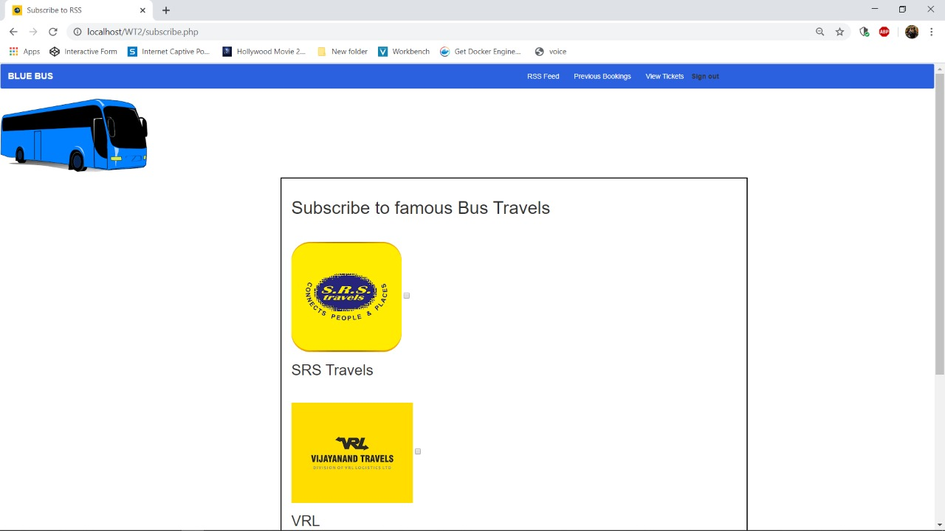
Project Description
BUS TICKET RESERVATION SYSTEM
Bus ticket reservation system is a web based application works within the centralized network. It provides facility to the User ,User can login into the webpage and can book the ticket. Traditional database is used to keep track of ticket booking that makes travel easy. And it maintain the record of the customer.

Slide 3
Technologies Used
Technologies Used
CSS,Javascript,PHP
Datadase Used
Sqlite3
Framework Used
Flask

Slide 4
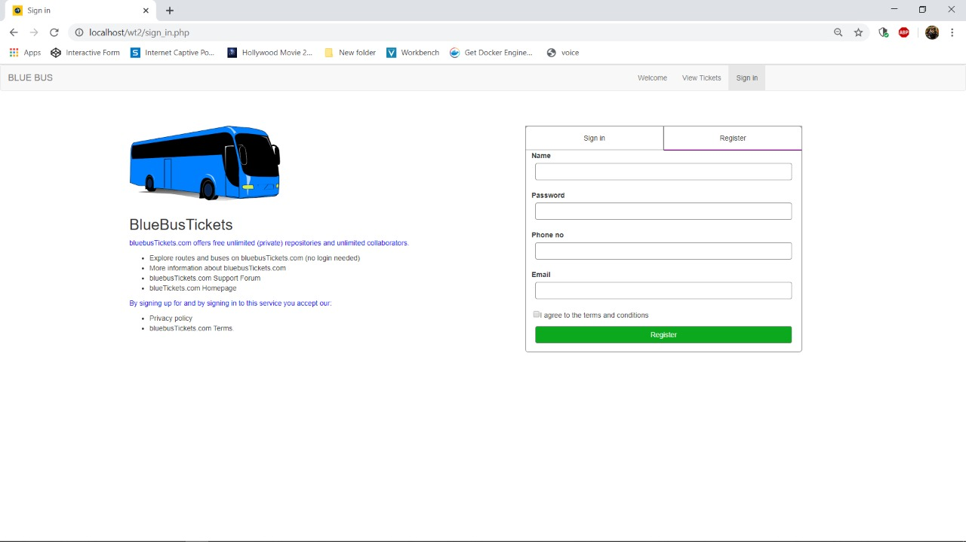
Techniques Implemented
Uses a hidden frame for registration.
Implements Submission Throttling to confirm if a name or number is available.
Uses multistage downloading to load the components of the page.
Static CSS and JS files are sent separately
Also implements Long Polling to keep track of dynamic pricing of the tickets.
Implements Predictive Fetch
Static JS and CSS files are sent separately

Slide 5
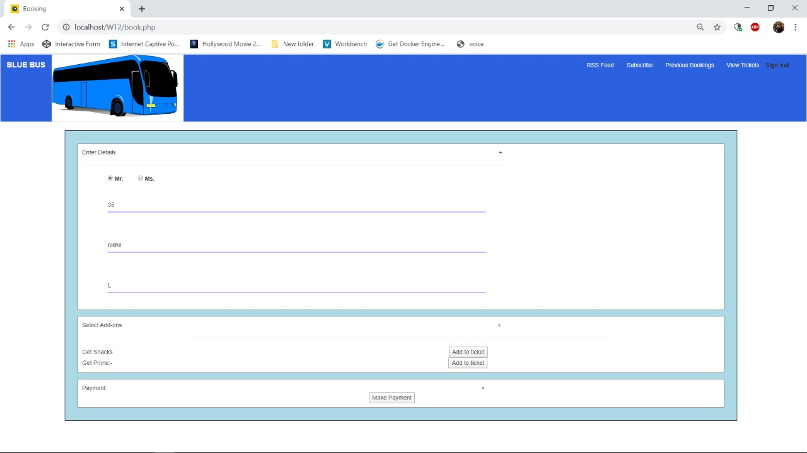
Intelligent Functionality
Intelligent Component
Calculate the discount the user gets.

Slide 6
Thank You

